Slide 1


SILLI POLYTECHNIC
(ESTD. BY GOVT. OF JHARKHAND &
RUN BY TECHNO INDIA UNDER PPP)
Approved by AICTE, Affiliated to JUT, Ranchi
An ISO 9001 :2015 Certified Institute
E-Commerce website
ZASH
Presented by:
Md Zafar Gayas(24)
Sourav Kumar(41)
Amar Murmu(05)
Harsh Kumar(18)
Project Guide-
Mr. Sayan Kundu Sir

Slide 2
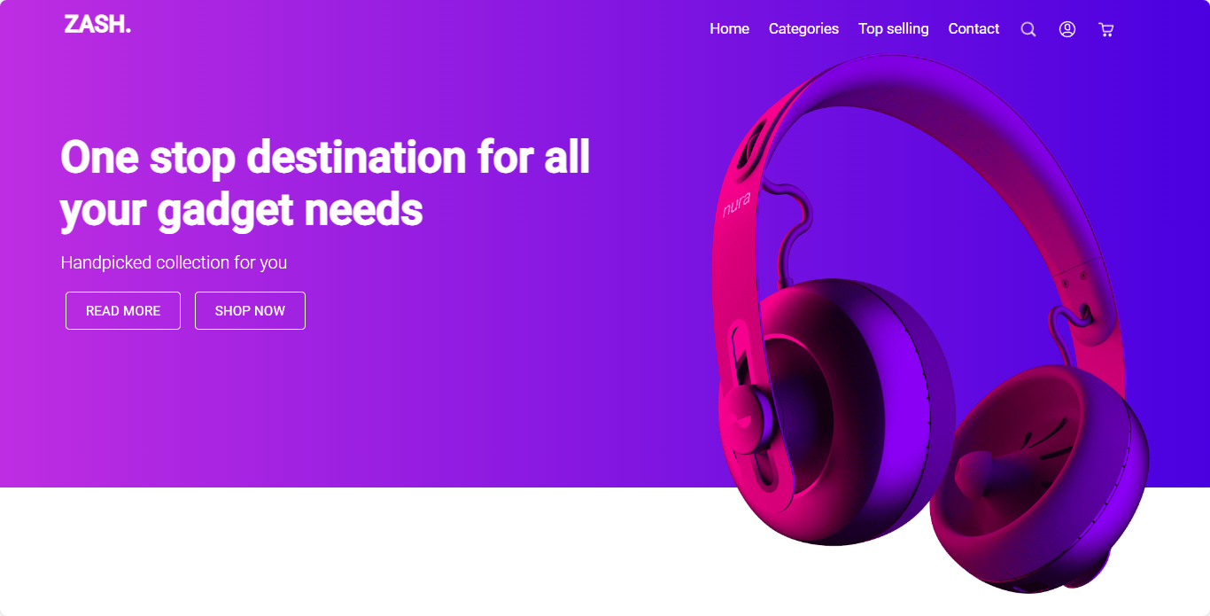
WELCOME
ZASH

Slide 3
CONTENT
INTRODUCTION
OBJECTIVE
BLOCK DIAGRAM
METHODOLOGY
TOOL USED
TECHNOLOGY USED
ADVANTAGES
DISADVANTAGES
SCREENSHOTS
REFERENCES

Slide 4
INTRODUCTION
ZASH is an online marketplace that specializes in selling electronic items such as smartwatches, headphones, and speakers.
The website offers a variety of products from different partnered brands.
Customers can browse through a wide range of options and select the ones that meet their needs and preferences.
ZASH aims to provide a seamless shopping experience to its customers by offering high-quality products at competitive prices, secure payment options, and reliable shipping services.

Slide 5
OBJECTIVE
The website aims to establish itself as a trusted and reliable platform for electronic item purchases, providing customers with detailed product information, customer reviews, and excellent customer service.
ZASH strives to offer a variety of options to customers to meet their needs and preferences, while also ensuring secure payment options and reliable shipping services.
Ultimately, the goal of ZASH is to become a one-stop-shop for all electronic item needs, providing customers with the latest and greatest products from top-quality brands.

Slide 6
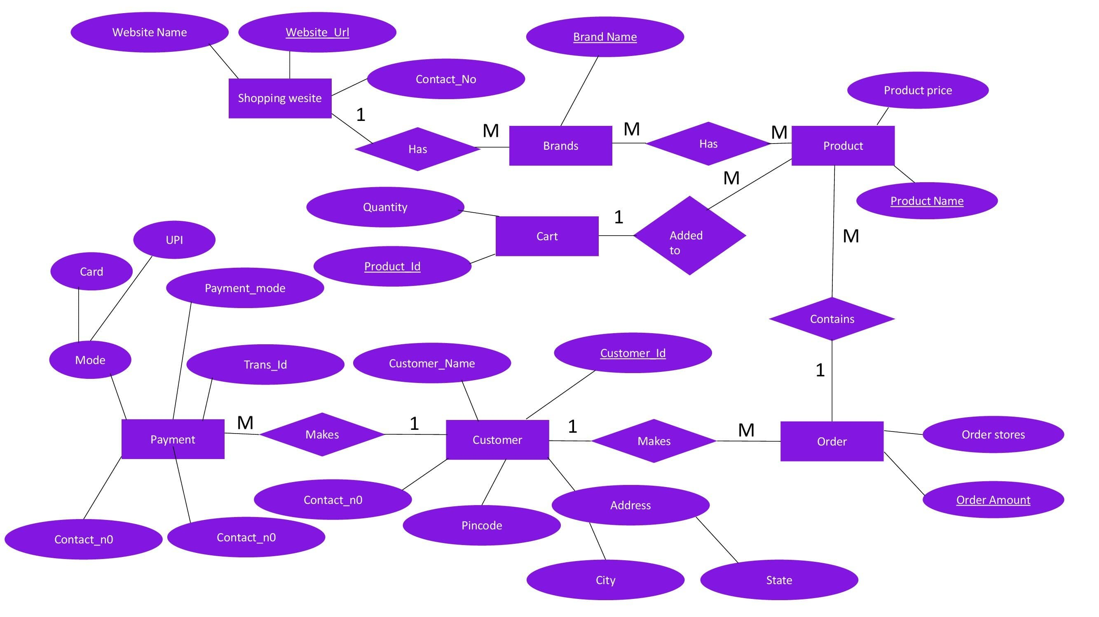
BLOCK DIAGRAM
Payment amount
Payment status
Payment Date

Slide 7
METHODOLOGY
Discovery
Design
Coding
Maintenance
Testing
Deployment

Slide 8
TOOL USED
Hardware
Rayzen 5
8GB DDR4 RAM
1TB Hard Drive
AMD radeaon 2GB Graphic Driver
Software
Visual Studio 2023
Microsoft Windows 11

Slide 9








TECHNOLOGY USED
HTML
CSS
Java Script
PHP
FontAwsome
MySQL
Razorpay SDK
Github

Slide 10
ADVANTAGES
Convenience
24/7 Availability:
Larger customer base
More product information
Personalized shopping experience
Secure payment options
Increased sales

Slide 11
DISADVANTAGES
Limited sensory experience
Dependence on technology
Lack of personal interaction
Security concerns
Shipping and delivery issues
Dependence on customer reviews
Lack of instant gratification

Slide 12
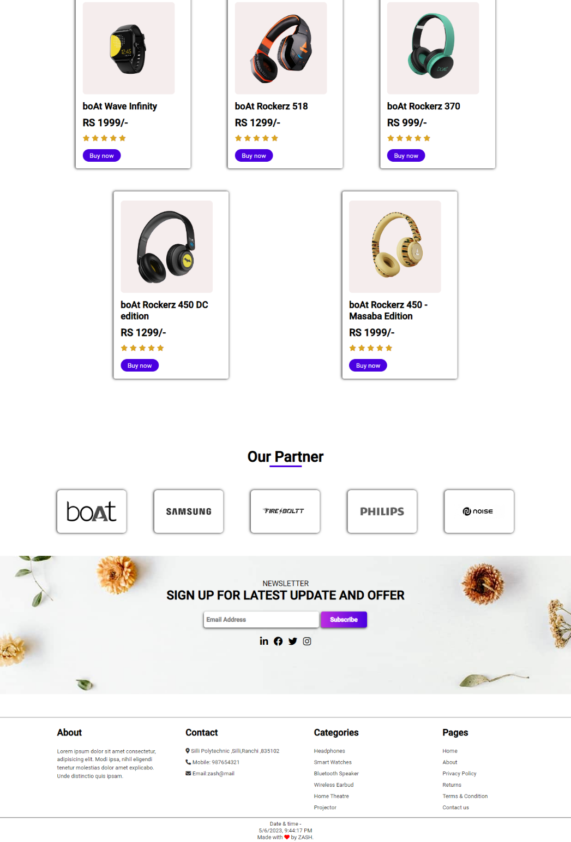
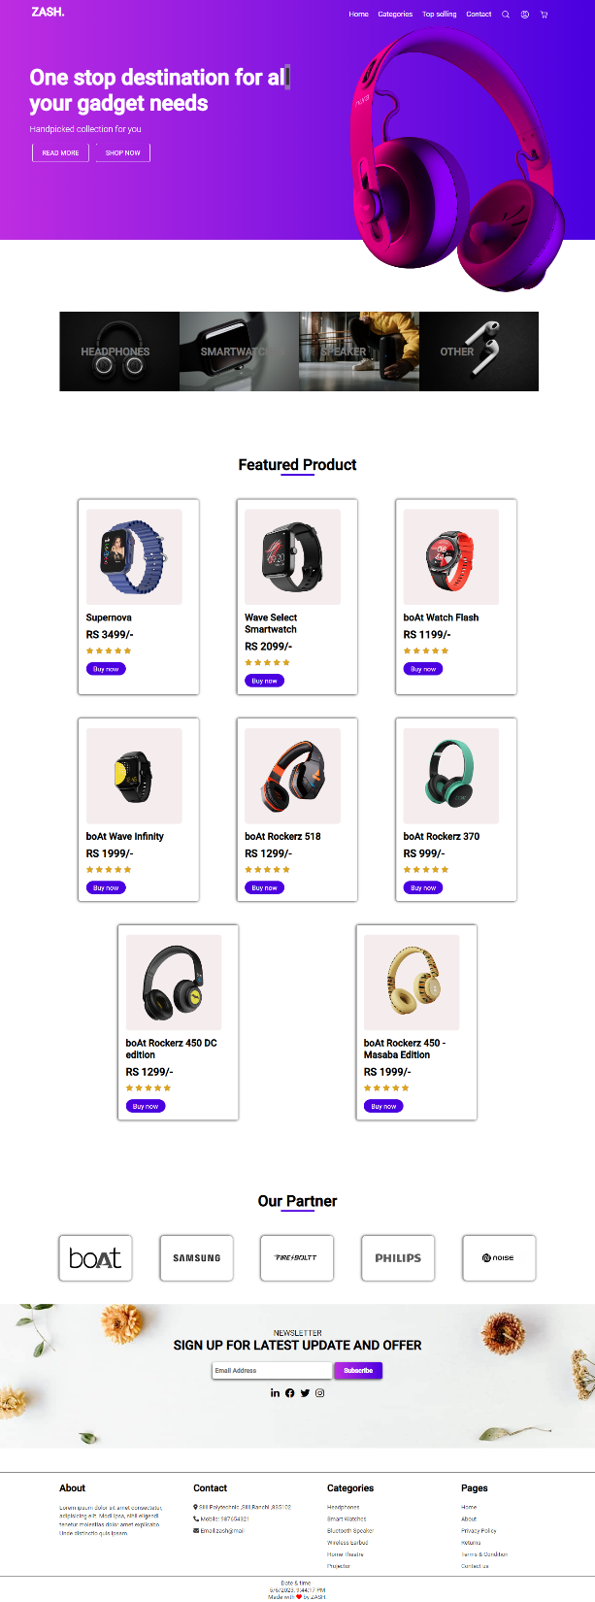
SCREENSHOTS

Slide 13
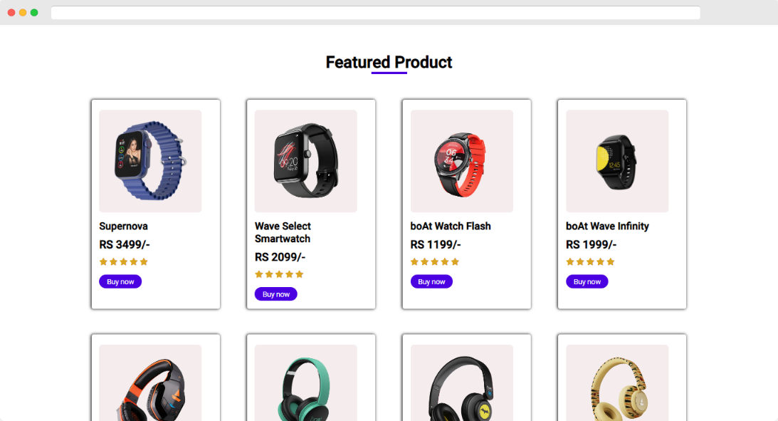

SCREENSHOTS
Home page

Slide 14
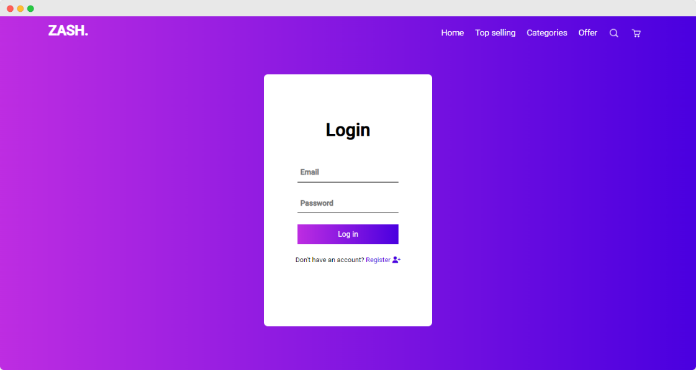
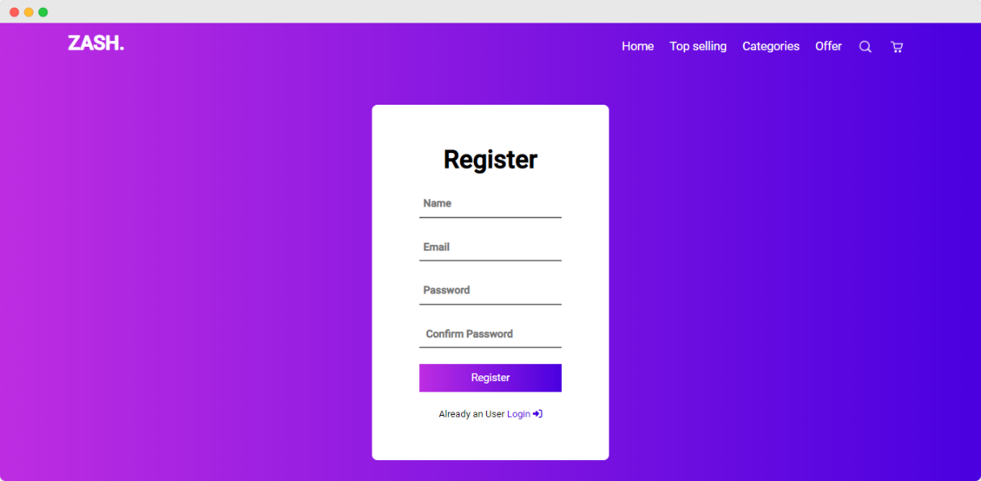
SCREENSHOTS
Login and Register page

Slide 15
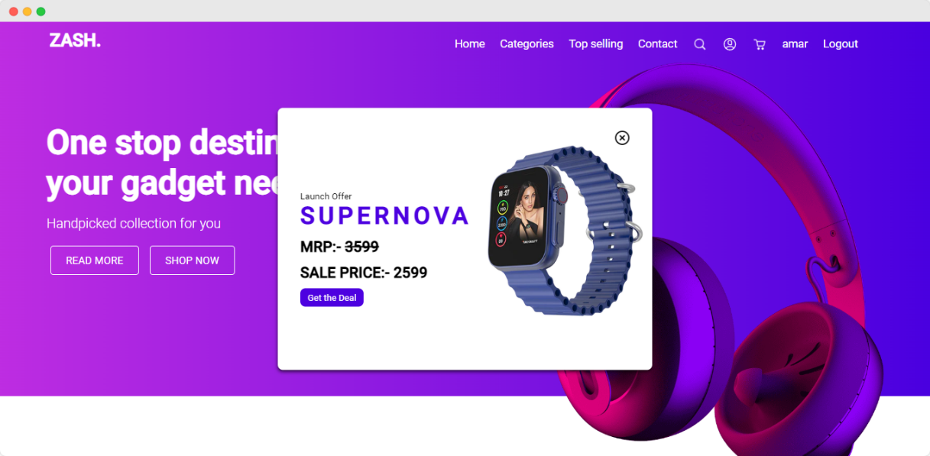
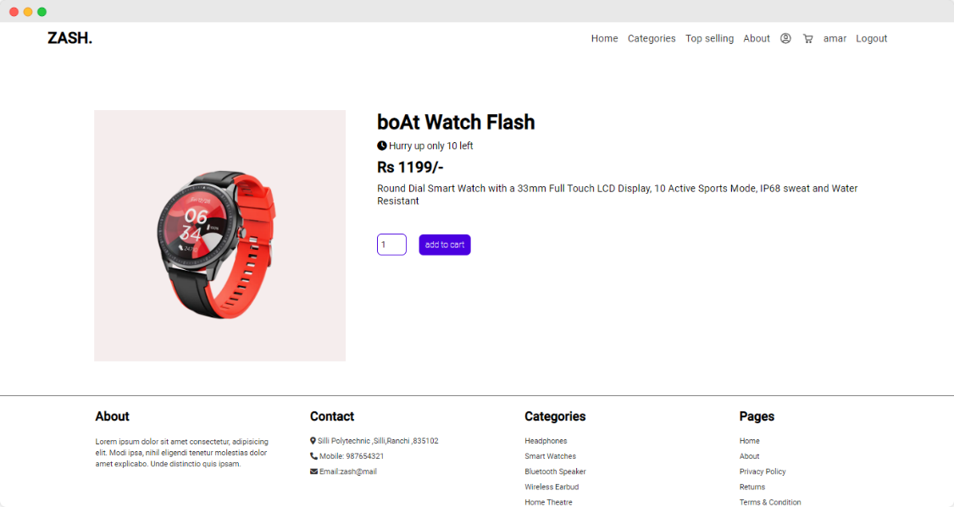
SCREENSHOTS
Offer Popup
Product Detail Page

Slide 16
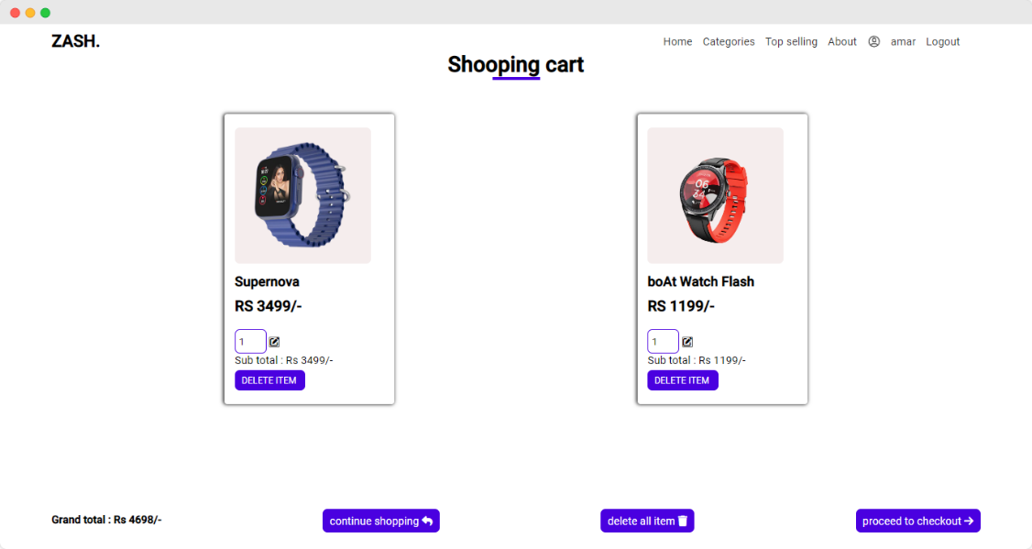
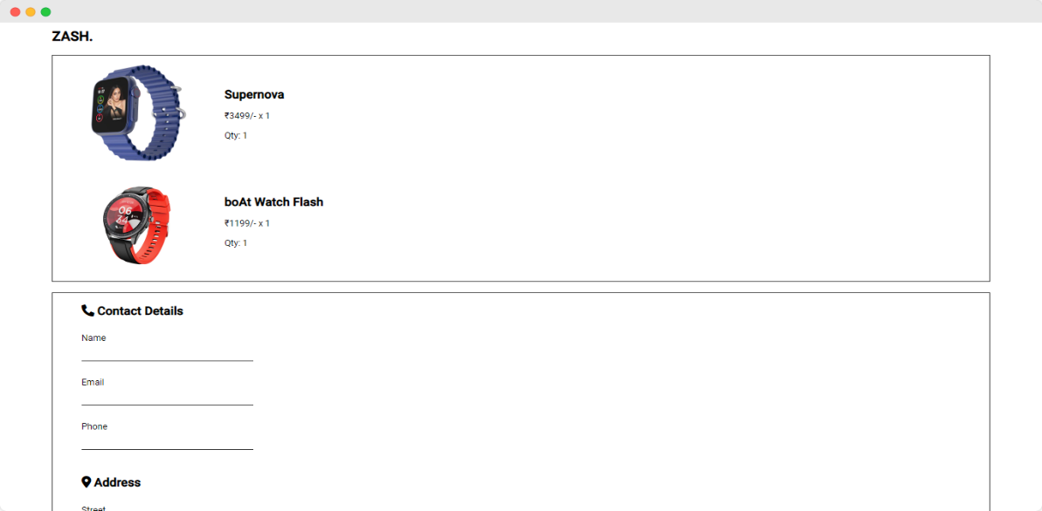
SCREENSHOTS
Cart
Checkout

Slide 17
SCREENSHOTS
Cart
Checkout

Slide 18
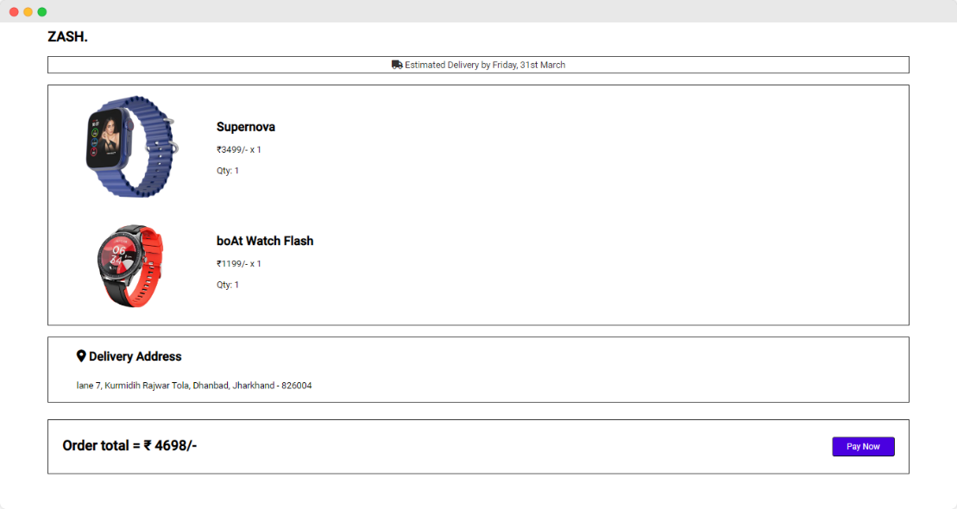
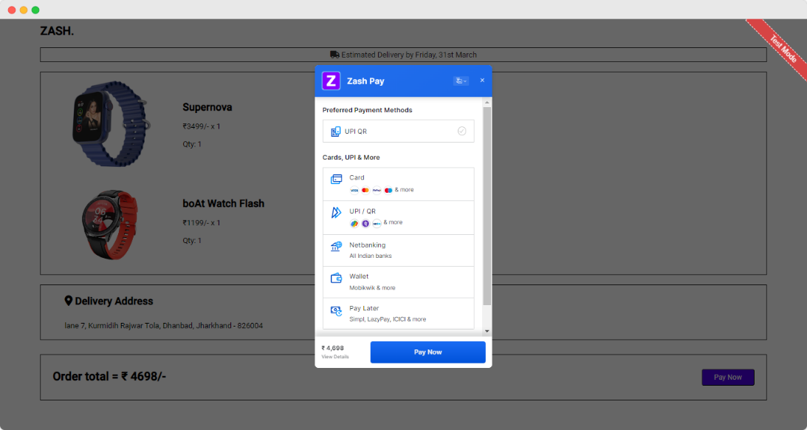
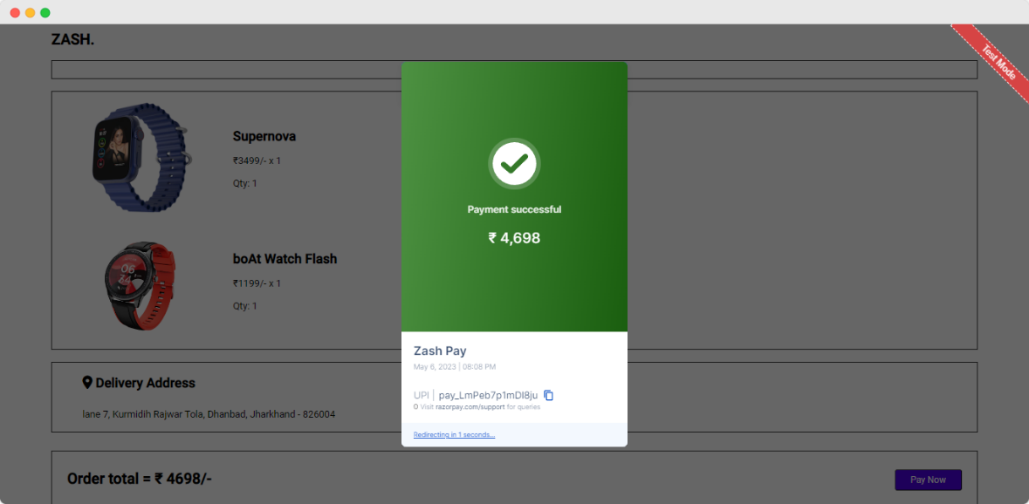
SCREENSHOTS
Payment Screen

Slide 19
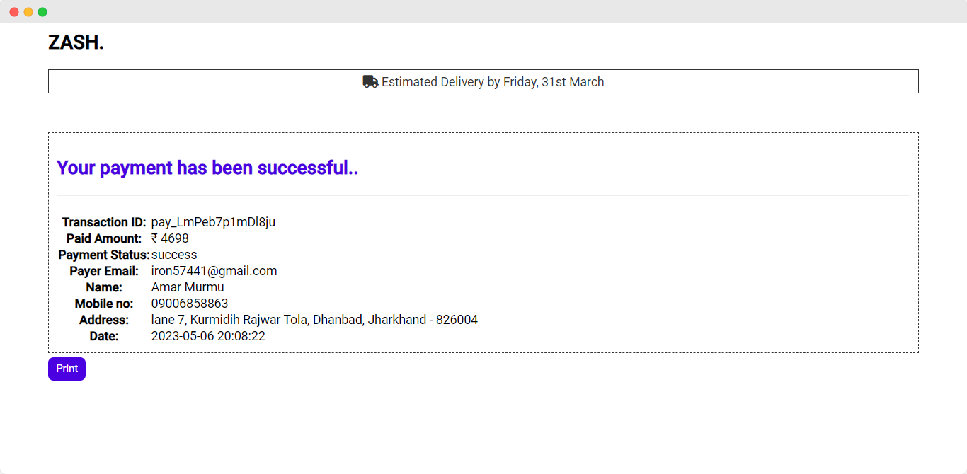
SCREENSHOTS
Payment reciept

Slide 20
REFERENCES
https://youtube.com/
https://www.boat-lifestyle.com/
https://www.fireboltt.com/
https://stackoverflow.com/

Slide 21
THANK YOU

